Slide 1
IHEI Competitors
Faraz Milani

Slide 2
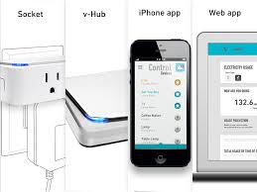
Valta
Uses compact wall sockets, central hub, and mobile/web app.
App Displays energy use vs. energy waste
Socket senses idle devices and prompts user to turn them off (which can be done via app)
vHub plugs into home router via ethernet
Socket/vHub use ISM (industrial scientific and medical) frequency band
Winner of Good Design Award 2013
Drawback: Does not automatically identify the device, only recognizes when it is idle

Slide 3
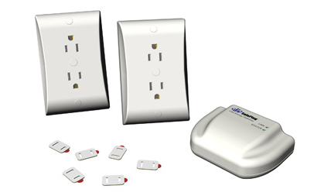
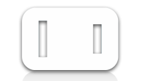
SafePlug
Energy Manager Outlet that plugs in on top of existing home outlets
Energy Manager Server that acts as the central hub
The server and outlet communicate via Zigbee Pro protocol
Server connects to internet and communicates with mobile/web app.
Reports energy usage per device an cuts “phantom power” when outlet switched off
Uses tags to communicate appliance power and current rating to SafePlug receptacle—before installing a tag, user must identify appliance power/current rating (amps/watts) and choose the closest match from the 13 tags
Drawback: Tag process takes extra time/not user friendly
Outlet will not turn on unless tags are used

Slide 4
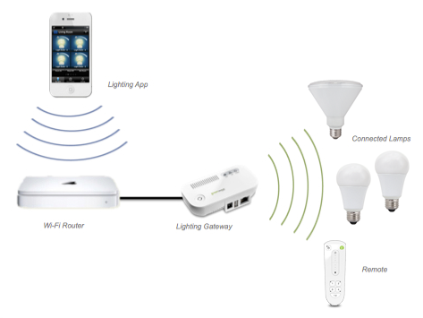
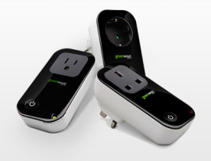
GreenWave
Lighting System
System that can control lighting based on a lighting gateway that communicates with wireless-enabled light bulbs made by their partners
WiFi router allows mobile apps to recognize and control each bulb, and view energy consumption
Also has remote control that can control light bulbs wirelessly
Drawback: Can only control lighting sources, which have to have wireless capability
Plug Load System
GreenWave power nodes/gateway; allows for plug load control from mobile apps using Zigbee/Zwave
Drawback: Bulky and impractical

Slide 5
Conclusion
The closest any company is to device recognition (on the market right now) is identifying when a device is idle
Our automatic device recognition must be emphasized to users as the key selling point

